Slide 1

Chapter 9
How to work with images
Brought to you by Table 5:
Michelle Bracey
Jan Cabonce
Wyatt Dunn
Matt Schroeder
Mike Spehar
Andrew Stein

Slide 2
Types of images
JPEG
GIF
PNG

Slide 3

JPEG
(Joint Photographic Experts Group)
Commonly used for the photographs and images on a web page
Typically used to display complex images with a small file size.
Information is lost when you compress a JPEG file, however the quality reduction of the image is not noticeable
Can represent millions of colors
Doesn’t support transparency

Slide 4

GIF
(Graphic Interchange Format)
Commonly used for logos, small images, or animated images that contain frames
Doesn’t lose information when compressed
Can use 256 colors
Does support transparency on a single color

Slide 5

PNG
(Portable Network Graphics)
Developed specifically for the web as a replacement of GIF files
Compressed PNG files are smaller than GIF files but still no information is lost
Can represent millions of colors
Supports transparency on multiple colors
Supported by all modern browsers and mobile devices

Slide 6
Image Code
Put images on your page!

Slide 7
HTML
Src - The relative or absolute url of the image to display. It is required
Alt - Alternate text to display in place of the image. It is required.
Height - The height of the image in pixels
Width - The width of the image in pixels
<p><img id=“small” src=“images/student.jpg” alt=“Teacher and Students” height=“300” width=“400”> </p>

Slide 8
CSS
Height - A relative or absolute value that specifies the height of the image if the height is different from its original size.
Width - A relative or absolute value that specifies the width of the image if the width is different from its original size.
#small{ height: 150px; width: 200px;}

Slide 9
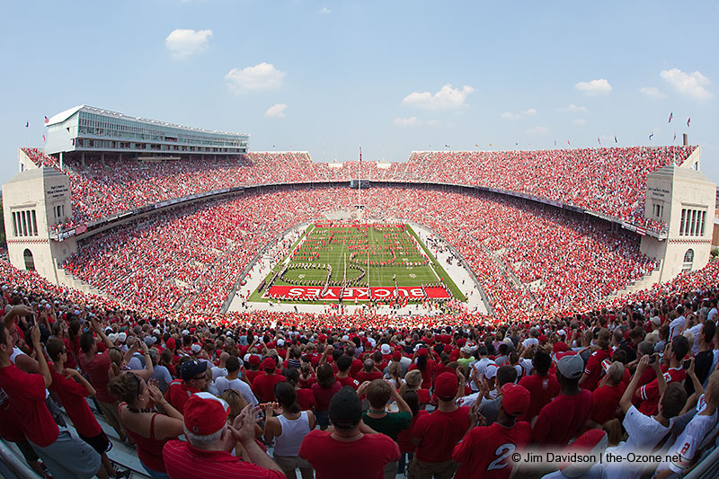
Image Position

Slide 10
Align
Vertical-align - A relative or absolute value or a keyword that determines the vertical alignment of the image.
Keywords:
Bottom - Aligns the bottom of the image box with the bottom of the box that contains the adjacent inline elements.
Middle - Aligns the midpoint of the image box with the midpoint of the containing block.
Top - Aligns the top of the image box with the top of the image box that contains the adjacent inline elements.
Text-bottom - Aligns the bottom of the image box with the bottom of the text in the containing block.
Text-top - Aligns the top of the image box with the top of the text in the containing block.

Slide 11
Float
Float - keyword that determines how the image is floated. Possible values are left, right, and none. None is the default.
Clear - Keyword that determines if an element that follows a floated element flows into the space left by the floated element. Possible values are left, right, both, and none. None is the default.

Slide 12

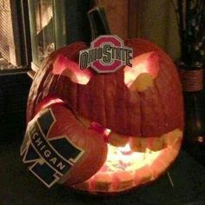
Advanced Skills

Slide 13
HTML5 figure and figcaption elements
The figure element can be used as a container for anything that is used as a figure, such as an image or a table.
The figcaption element can be used within a figure to provide a caption that describes that figure. It is optional. By default, figcaption element is an inline element and typically needs to be changed.

Slide 14
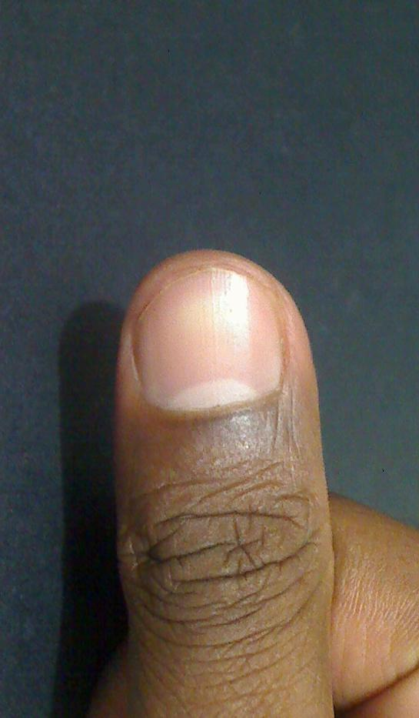
Thumbnails
A thumbnail is a small version of an image that can be used to make downloading an image faster and to save space on a web page.
To create a thumbnail you can use an editor to resize the image.
A thumbnail can be used as the image for the link that displays a page with a larger version of the image.

Slide 15
Rollover
Image rollover is an image that gets changed when the mouse hovers over it.
One way to do image rollovers is to use background images and the :hover pseudo-class selector .
Using this method, the designated image will be displayed when the user hovers over the original image

Slide 16
Image map
You can use the map and area elements to define an image map that provides clickable areas for the image called hotspots
The coordinates for an area are relative to the upper left corner of the image and are measured in pixels.

Slide 17
Image maps (continued)
Img element attributes:
Usemap: Identifies the related map element. The value is the value of the name attribute of the map element, preceded by the pound (#) sign.
Map element attributes:
Name: provides a name for the map.
Area element attributes:
Href: specifies relative or absolute URL to identify the page that will be displayed when the area is clicked.
Shape: keyword to indicate the type of shape that an area represents. Possible keywords: rect, circle, poly, and default (same as rect)
Coords: values that indicate the shape and location of the area. Two sets of x,y coordinates are required for a rectangle to identify the upper left and lower right corners.
Alt: Text that is displayed in place of the area if the image cant be displayed.
Example Code:
<img scr=images/html.gif” alt=“Dreamweaver and jquery books” usemap=“#books”>
<map name=“books”>
<area href=“Dreamweaver.html” alt=“Dreamweaver book” title=“Dreamweaver shape=“poly” cords=“1,19,114,0,122,53,106,143, 26, 149”>
<area href=“Jquery.html” alt=“Jquery book” title=“Jquery” shape=“poly” cords=“128, 21, 241, 42, 218, 178, 103, 159”>
</map>

Slide 18

Image Procurement

Slide 19
Image Editors
Adobe Photoshop CC (expensive)
Adobe Photoshop Elements (inexpensive)
GIMP - GNU Image Manipulation Program (free)
MS Paint (comes with Windows)

Slide 20
Finding images and icons
Images
www.sxc.hu
www.freefoto.com
www.openphoto.net
www.google.com/imghp
Icons
www.glyphicons.com
www.flaticon.com
www.iconarchive.com

Slide 21
Favicons
A favicon is a small image that appears to the left of the title in the browsers tab for the page. It can also appear to the left of the url in the address bar or as a book mark.
A favicon is usually 16 pixels wide and tall and has the extension ico since that is the only extension supported by Internet Explorer.
You can create an ico file by using an icon editor, a program that converts an image to an ico file.
www.axialis.com/iconworkshop/
www.html-kit.com/favicon
<link rel=“shortcuts icon” href=“images/favicon.ico”>

Slide 22
Creative Commons License
Attribution - You can use the image as long as you give it credit as requested by the author or website who provided the image.
Share alike - You can distribute the image based on the license that governs the original work.
Non-commercial - You can use the image for non-commercial purposes only.
No derivative works - You can only use the original image and not those derived from it.

Slide 23
The End!

